Slide 1
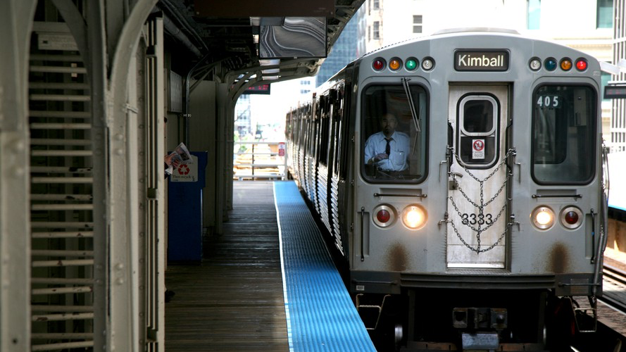
SECURITY ON PUBLIC TRANSPORTATION IN CHICAGO
GROUP 6 | Jainam Mehta, Julian Kleindiek, Lola Johnston, Peter Eusebio

Slide 2
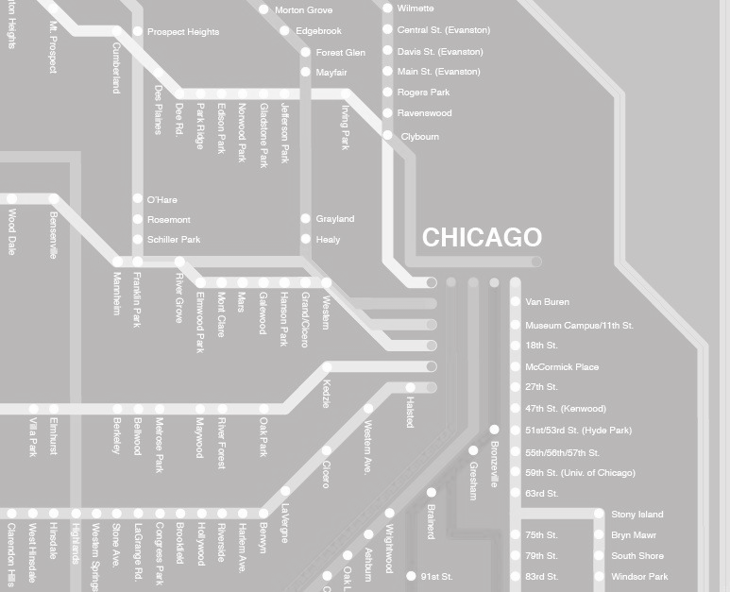
AGENDA
Executive Summary & Business Case
Data Overview & Preparation
Database Design
Solution Architecture
Data Analysis & Analytics Dashboard
Conclusions

Slide 3
EXECUTIVE SUMMARY
Crime on public transportation and in its surroundings is severe in Chicago, posing a threat to consumers and a challenge to law enforcement authorities
Many of the UChicago students are frequently using public transportation and hence affected by this issue
The objective of this project is to discover patterns in the occurrence of crime on and around public transportation
The insights derived will be used to:
Give consumers guidance on the risk related to taking the route that they are anticipating to take
Help authorities understand what factors contribute to spikes in crime and give recommendations on how to provide more safety on public transportation
Notes:
Julian

Slide 4
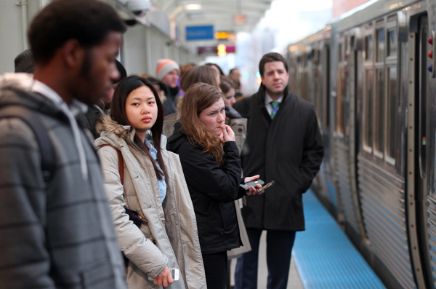
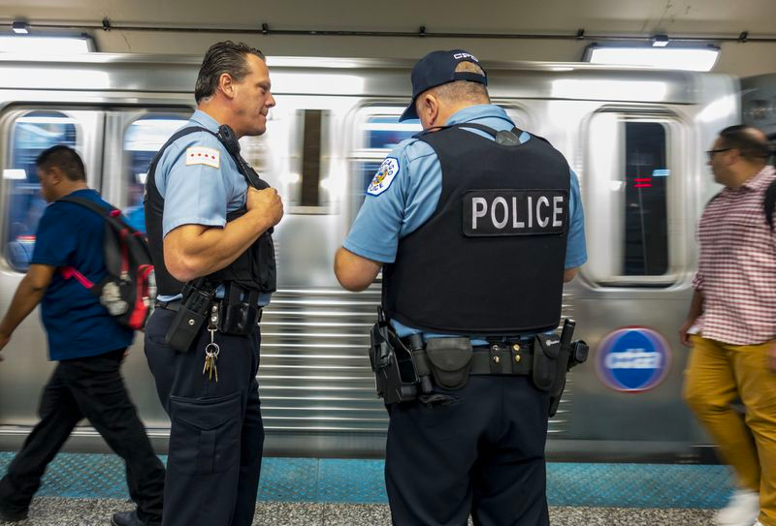
BUSINESS USE CASE
Exposed to crime on public transportation
Lack of information on the safety of taking public transportation
Avoiding dangerous routes as a tourist
Trade off between safety and cost for transportation
Lack of safer options
Chicago’s reputation as one of the most dangerous cities in the US
Inability to ensure safety and prevent crime on public transportation
Lack of information on how external factors influence crime on public transportation
Lack of information on where to increase staffing and presence
Any person using public transportation in Chicago, including commuters, residents and tourists
Any organization responsible for providing safety on public transportation in Chicago e.g. CPD, private security
Notes:
Skip

Slide 5
SOLUTION AND IMPACT
Provide insights into the risk level of using a given means of public transportation at a given point in time
Provide greater transparency on the safety of different public transport options
Provide insights into how to increase safety on public transportation by unveiling dominant crime patterns
Provide predictive information on when to anticipate heightened crime, and help improve staffing efficiency
CONSUMER
AUTHORITIES
Notes:
Skip

Slide 6
DATA OVERVIEW & PREPARATION
Notes:
The ETL steps

Slide 7

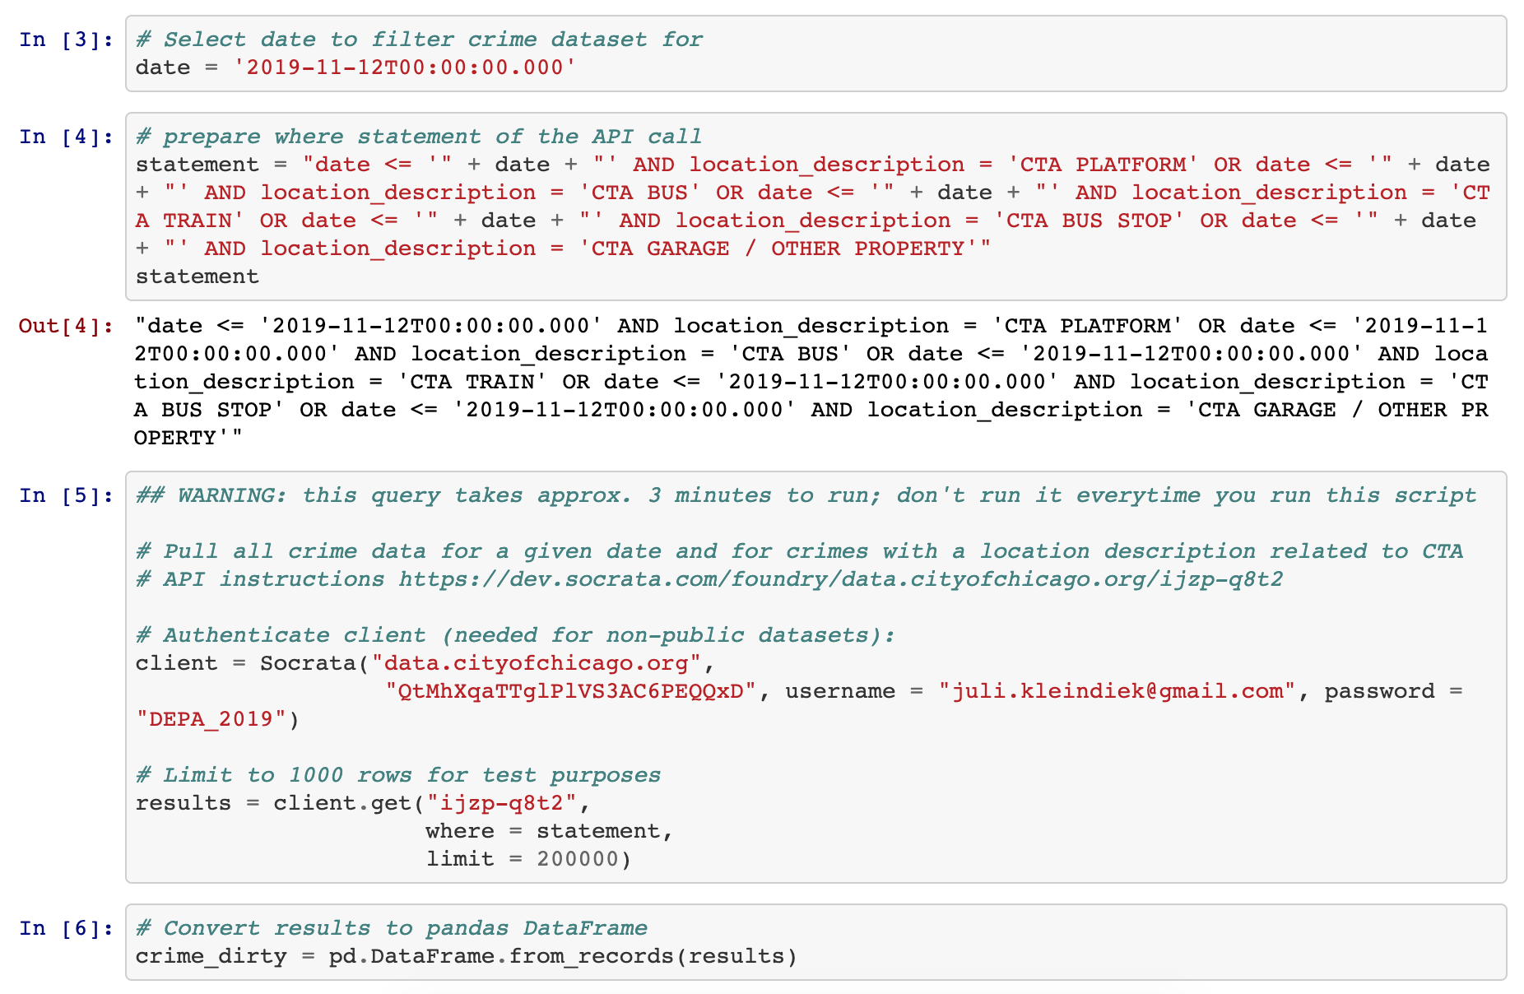
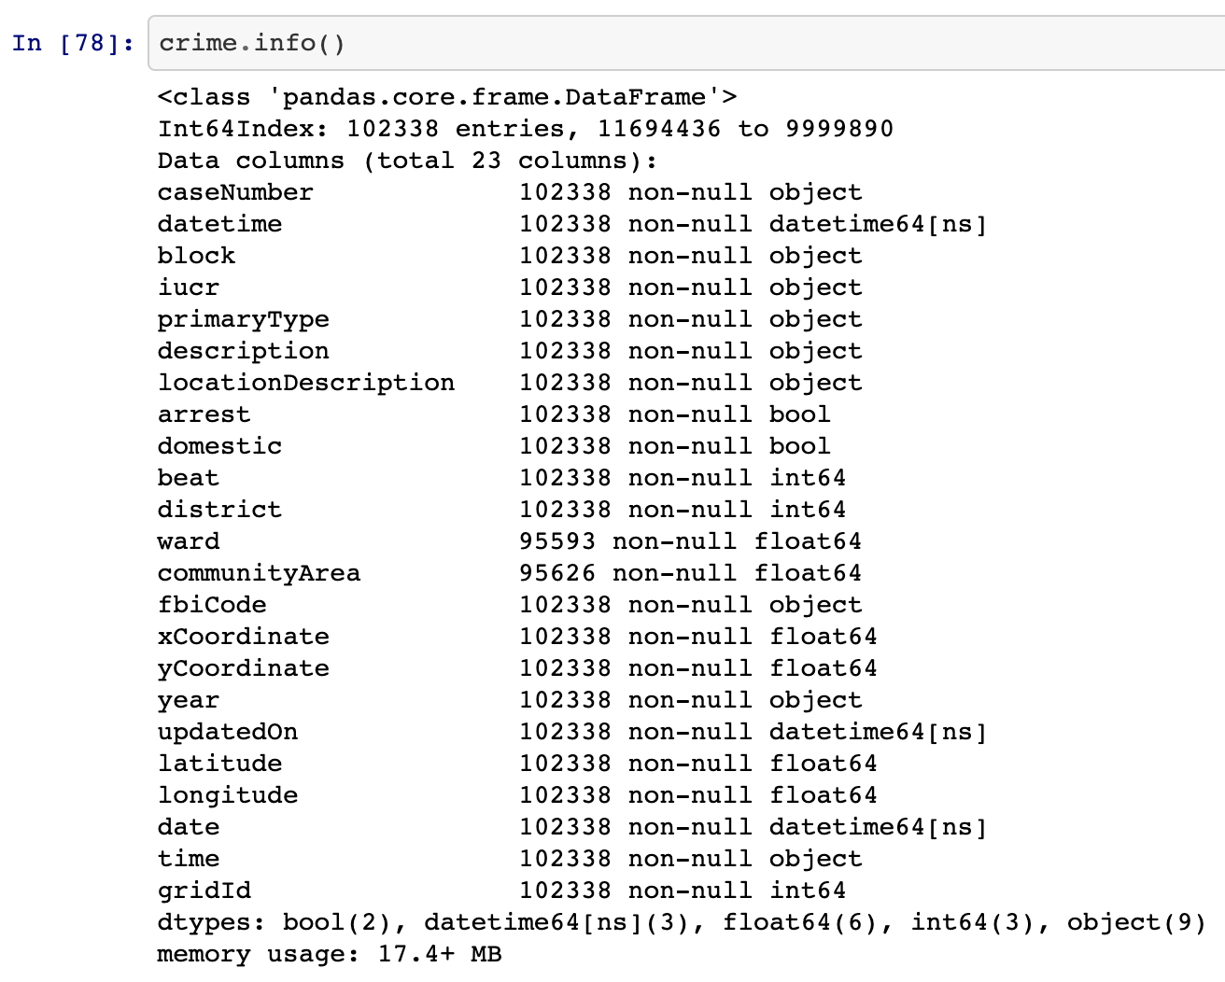
DATA OVERVIEW | CRIME
We accessed the crime statistics published here by the City of Chicago via an API, filtering for all CTA-related crime cases. We then cleaned the data in Python according to our needs.
API Call | Resulting crime Data Frame
Notes:
Jainam
Dataset was retrieved from the City of Chicago portal, through an API call.
Just over 100000 datapoints for crime occuring at CTA locations, from 2001 to present.
We had various information such as the case number, CTA location type (e.g. bus stop, bus, platform or train), type of crime (theft, battery, etc) along with the latitude and longitude information for where the crime occurred.
Cleaned the data through various steps, including trimming whitespaces, correcting column names, datatypes. Null values were checked for, and removed if occurring in the lat or long columns.

Slide 8

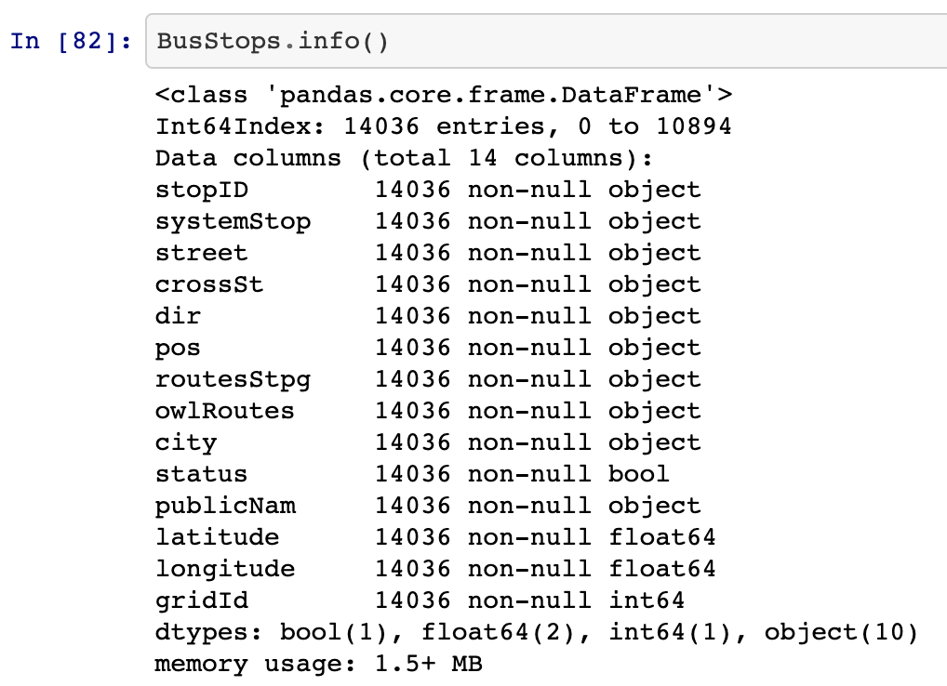
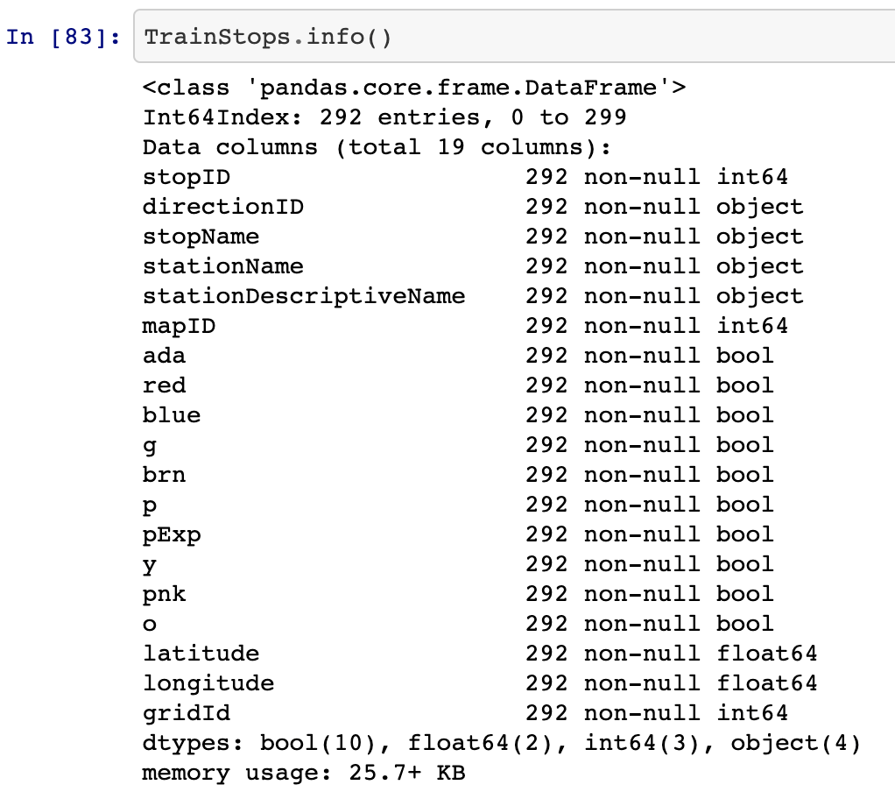
DATA OVERVIEW | PUBLIC TRANSPORTATION
We download the data on Train Stops here and on Bus Stops here and then imported it into Python where we clean it according to our needs.
Resulting BusStops Data Frame | Resulting TrainStops Data Frame
Notes:
Jainam
Data was retrieved from the City of Chicago portals through a dbf and csv file respectively.
About 11,000 bus stops and 290 train stops in Chicago
For bus stops, while we didnt go up to 3NF, we had to normalize the routesStpg column to split out multiple routes. W
Cleaning wise, the lat long values were separated, datatypes were assigned.

Slide 9

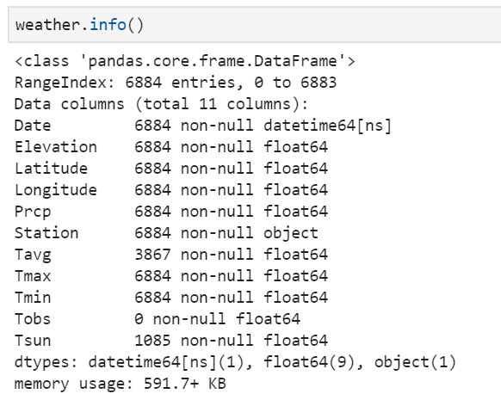
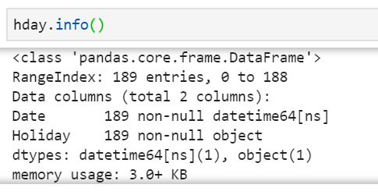
DATA OVERVIEW | WEATHER AND HOLIDAYS
The Weather dataset contains various metrics (temperature, precipitation) from 2001 to present. The holidays dataset contains a list of US holidays and their corresponding dates.
Information on the weather data | Information on the holiday data
Notes:
Jainam
Data retrieved from government sources.
For weather, we originally had 13 stations around Chicago, so we narrowed down to the one with the most data, which in this case was at O’Hare. We have data from 2001 to present, with one record for each day which totals to 6884 datapoints.
For the holidays dataset, we have a list of US holidays, with their corresponding dates.
For cleaning, the dates were formatted for consistency.

Slide 10
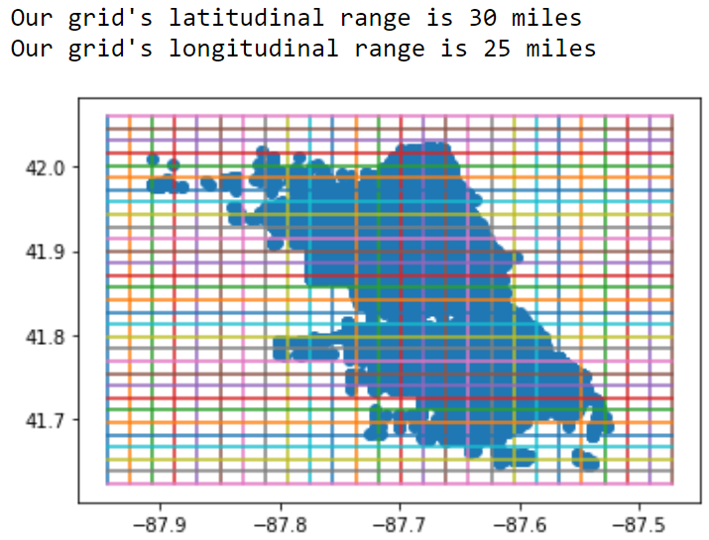

DATA OVERVIEW | GRID TABLE
A grid of 1x1 mile squares was generated around the crime report locations.
Map of crime reports inside the grid | Code for grid assignment
Notes:
Peter

Slide 11
DATABASE DESIGN

Slide 12
DESIGN CONSIDERATIONS
The key to setting up a functioning database was the creation of a grid table that enabled us to join the crime table with the bus and train stop tables
Data is organized in an Enhanced Entity Relationship (EER) diagram
A star schema was not created because:
The database doesn’t have many tables, making joins relatively easy and computationally inexpensive to perform
The crime data itself is updated daily but by a relatively low amount of new rows (approx. 14 on average)
The EER best communicates the relationships between the distinct data sources
Revealing the relationship between these data sources is the purpose of our project
Notes:
Peter

Slide 13
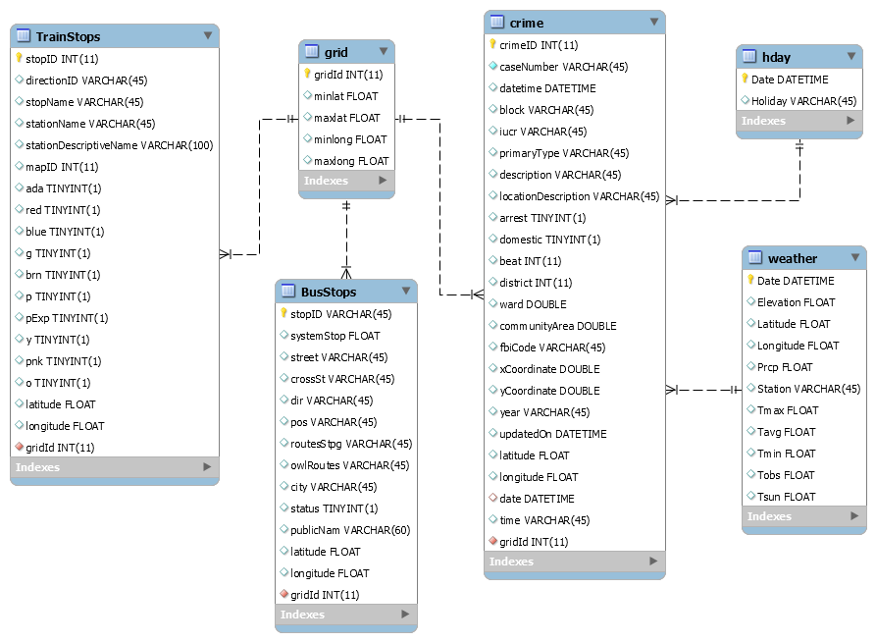
Enhanced Entity Relationship diagram
Grid table allows joins of the crime table with the BusStops and TrainStops tables using gridId as foreign key
Holiday and weather tables connect directly into the crime table using date as foreign key
Notes:
Peter- did not use star scheme because EER best communicates the relationships between our distinct data sources. Revealing the relationship between these data sources is the meat of our project. lol we didn’t even need a grid table we could’ve used gridId as foreign key between stops and crime

Slide 14
SOLUTION ARCHITECTURE

Slide 15



PLATFORM CONSIDERATIONS
PREPARATION
DATABASE
VISUALIZATION
DATABASE
Alternatives: OpenRefine
Programmatic tool compared to OpenRefine which requires GUI
Wider availability of packages (pandas, numpy)
Ability to directly interface with SQL server
Alternatives: AWS, Azure
Greater familiarity with GCP compared to other platforms
Ease of access through shell directly within Chrome
Availability of free credits
Alternatives: PowerBI, Metabase
Better performance on high volume datasets
PowerBI workspace has a limit of 10GB data
Greater flexibility in connecting with database sources and servers
Alternatives: AWS, Azure
Greater familiarity with GCP compared to other platforms
Ease of access through shell directly within Chrome
Availability of free credits

Slide 16

SOLUTION ARCHITECTURE
Data
Crime
TrainStops
BusStops
GridId
Holiday
Weather
Cloud SQL
stores all cleaned data
Risk Score Development
Data Visualization
Pull
Clean
Prepare
Process
Bucket
stores .py script for daily API call of crime data
Compute Engine
executes the .py script daily at 8:00 AM CT and appends new data to Cloud SQL
Notes:
As mentioned earlier, we do all our data preparation and processing in python. One preparation step that I wanted to call out here is for the GridId. As you will see in a bit, we visualize the grids in Tableau. For areas this is however a bit tricky as you need to create polygons of the latlong-boundaries and create a shapefile from it, which we did. All data is then pushed into Cloud SQL…

Slide 17
DATA ANALYSIS & ANALYTICS DASHBOARD

Slide 18


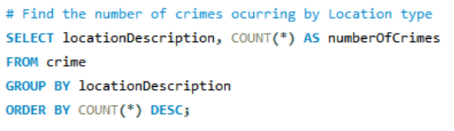
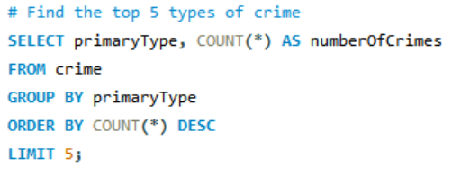
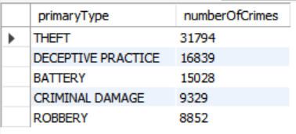
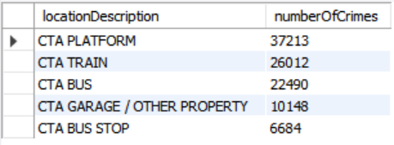
INSIGHTS | QUERY
Most number of crimes occured on CTA Platforms
Finding the top 5 types of crime
Notes:
Jainam

Slide 19
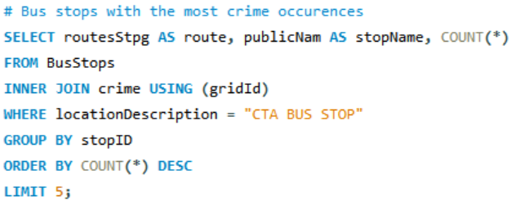
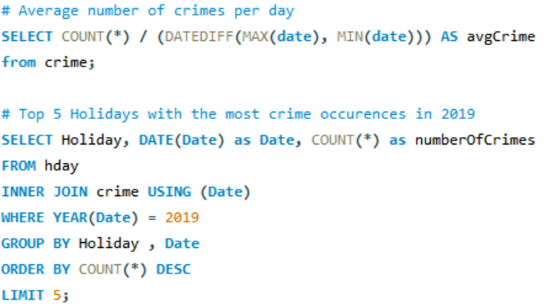
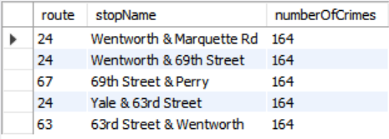
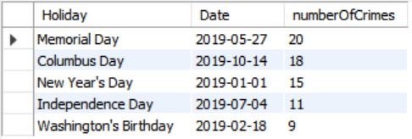


INSIGHTS | QUERY
Holiday with the most crime (2019)
Bus Stops with the most crime
Average Crimes per day: 14.85
24 - Wentworth
Memorial Day
Notes:
Jainam

Slide 20
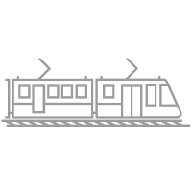
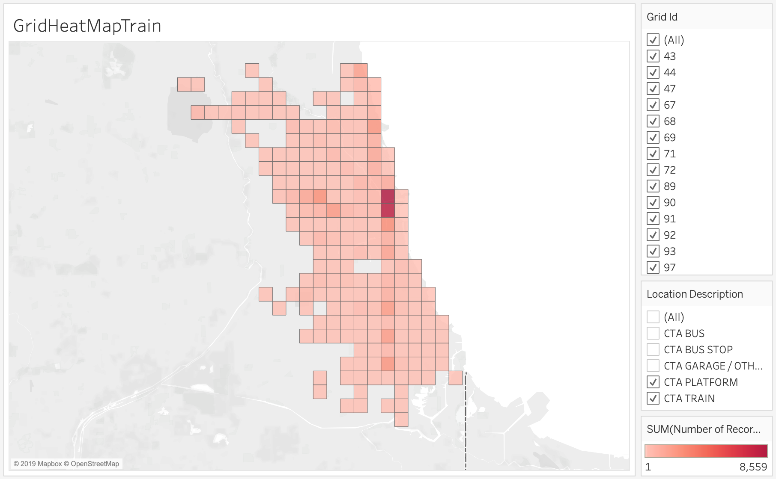
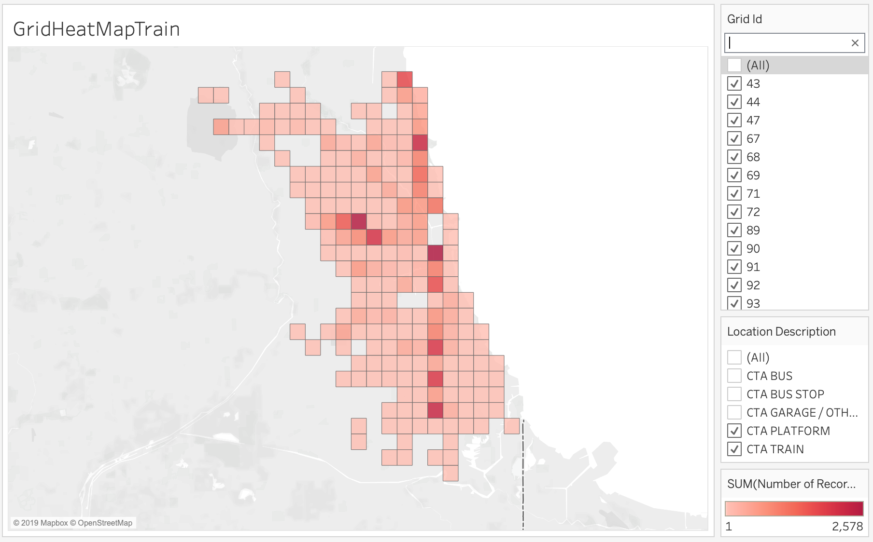
INSIGHTS | VISUAL Taking the train in Chicago
Riskiest areas for Train Riders: The downtown area, the south and west side
All train-related crimes | Train-related crimes excluding downtown (outlier)
Crime (2001 - present)
Notes:
We wanted to find out the riskiest areas when you’re taking the train and we found that its downtown, south and west side. On the left we see a heatmap of the grids with all train-related crimes. On the right we excluded the downtown grids as they were a big outlier with 8.5k crimes.

Slide 21

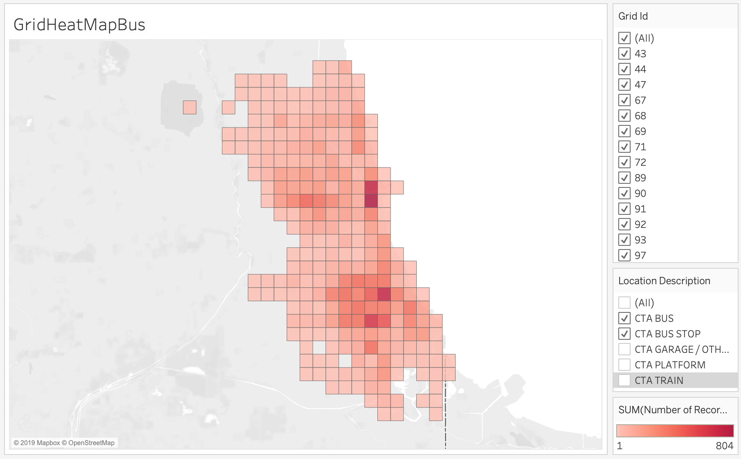
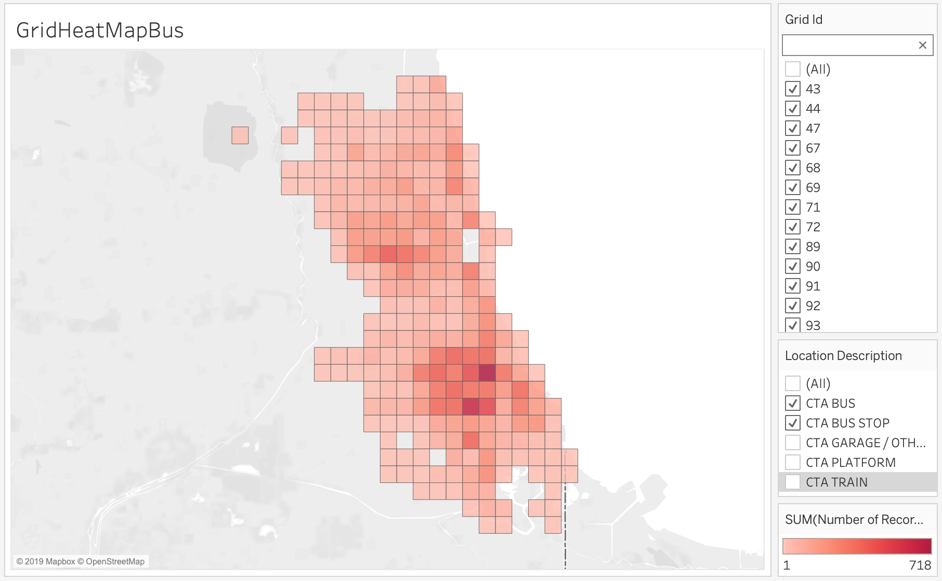
INSIGHTS | VISUAL Taking the bus in Chicago
Riskiest areas for Bus Riders: Downtown and the South Side There are much more crimes on trains (max. # of crimes on trains: 8,599 vs. 804 on buses)
All bus related crimes | Bus-related crimes excluding downtown (outlier)
Crime (2001 - present)
Notes:
These visualizations show the difference to taking the bus. The first thing we recognize is that there are far less bus-related crimes (max. 800 vs. 8.5k). And if you’re taking the bus, downtown and southside are the riskiest. Compared to trains, the downtown grids are not that much of an outlier.

Slide 22

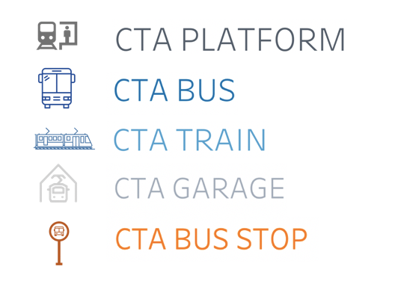
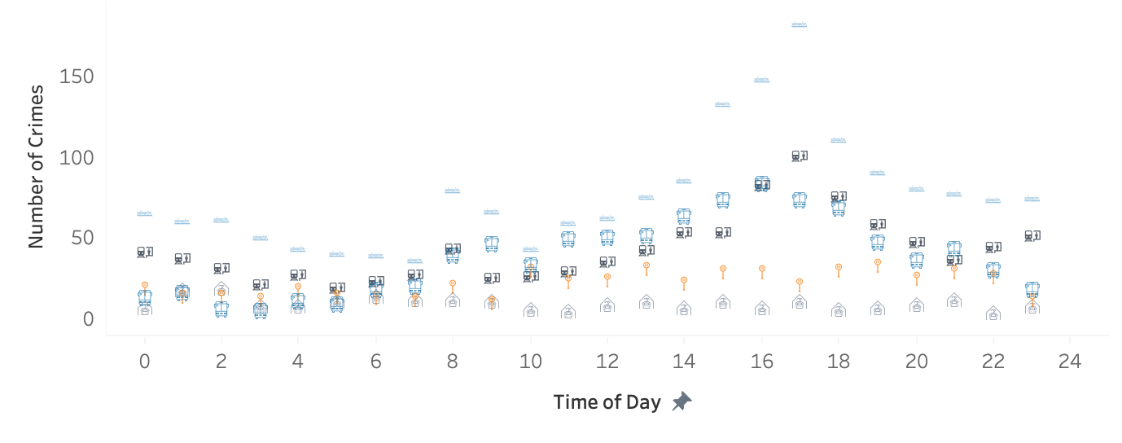
INSIGHTS | VISUAL Crime & Time
Crimes occur most frequently during rush hour -- highest in the evening. Trains are especially risky between 2pm - 7pm
Crime by the hour by location type (2019 - present)
Notes:
Factor to investigate: Time
Tool used: Tableau
Explain the graph:
Number of crimes by the hour
Icons & color by loc type
Takeaway:
Trains are riskiest
Highest volume of crime occurs between 2 - 7pm

Slide 23

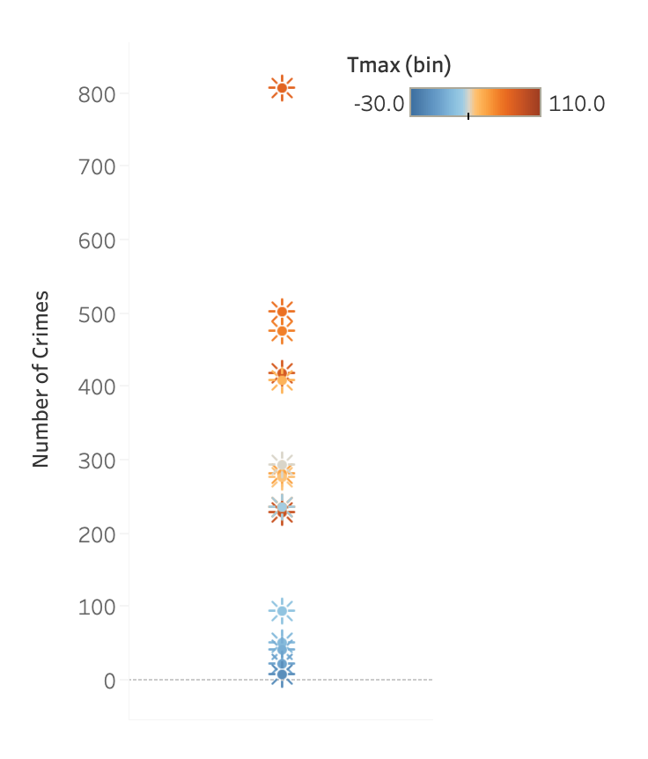
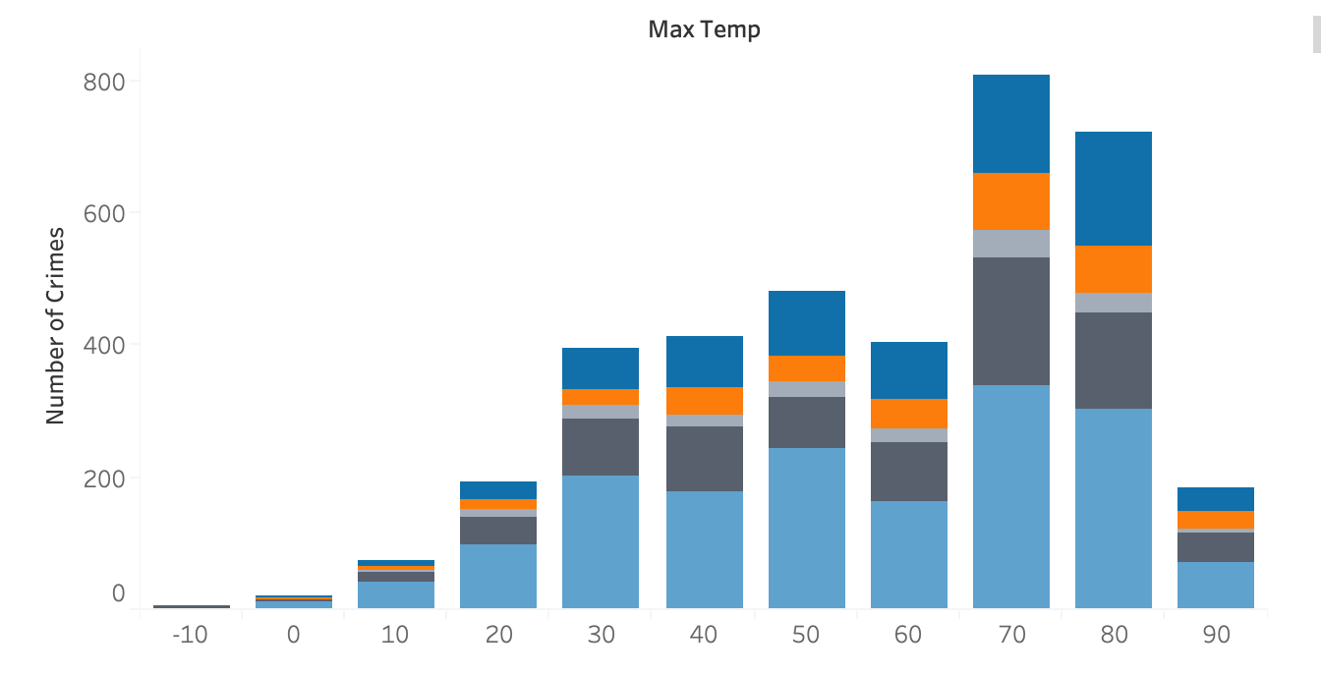
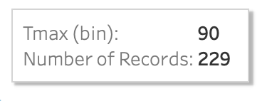
INSIGHTS | VISUAL Crime & Temperature
Crimes increase with warmer weather -- until temperatures hit 90+ degrees
Crimes by temperature (2019 - present)
Notes:
Factor: temperature
Explain the graphs:
Two graphs, Two different views
Number of crimes by temperature
Takeaway:
Crimes increase with warmer weather
drops drastically at over 90 degrees

Slide 24
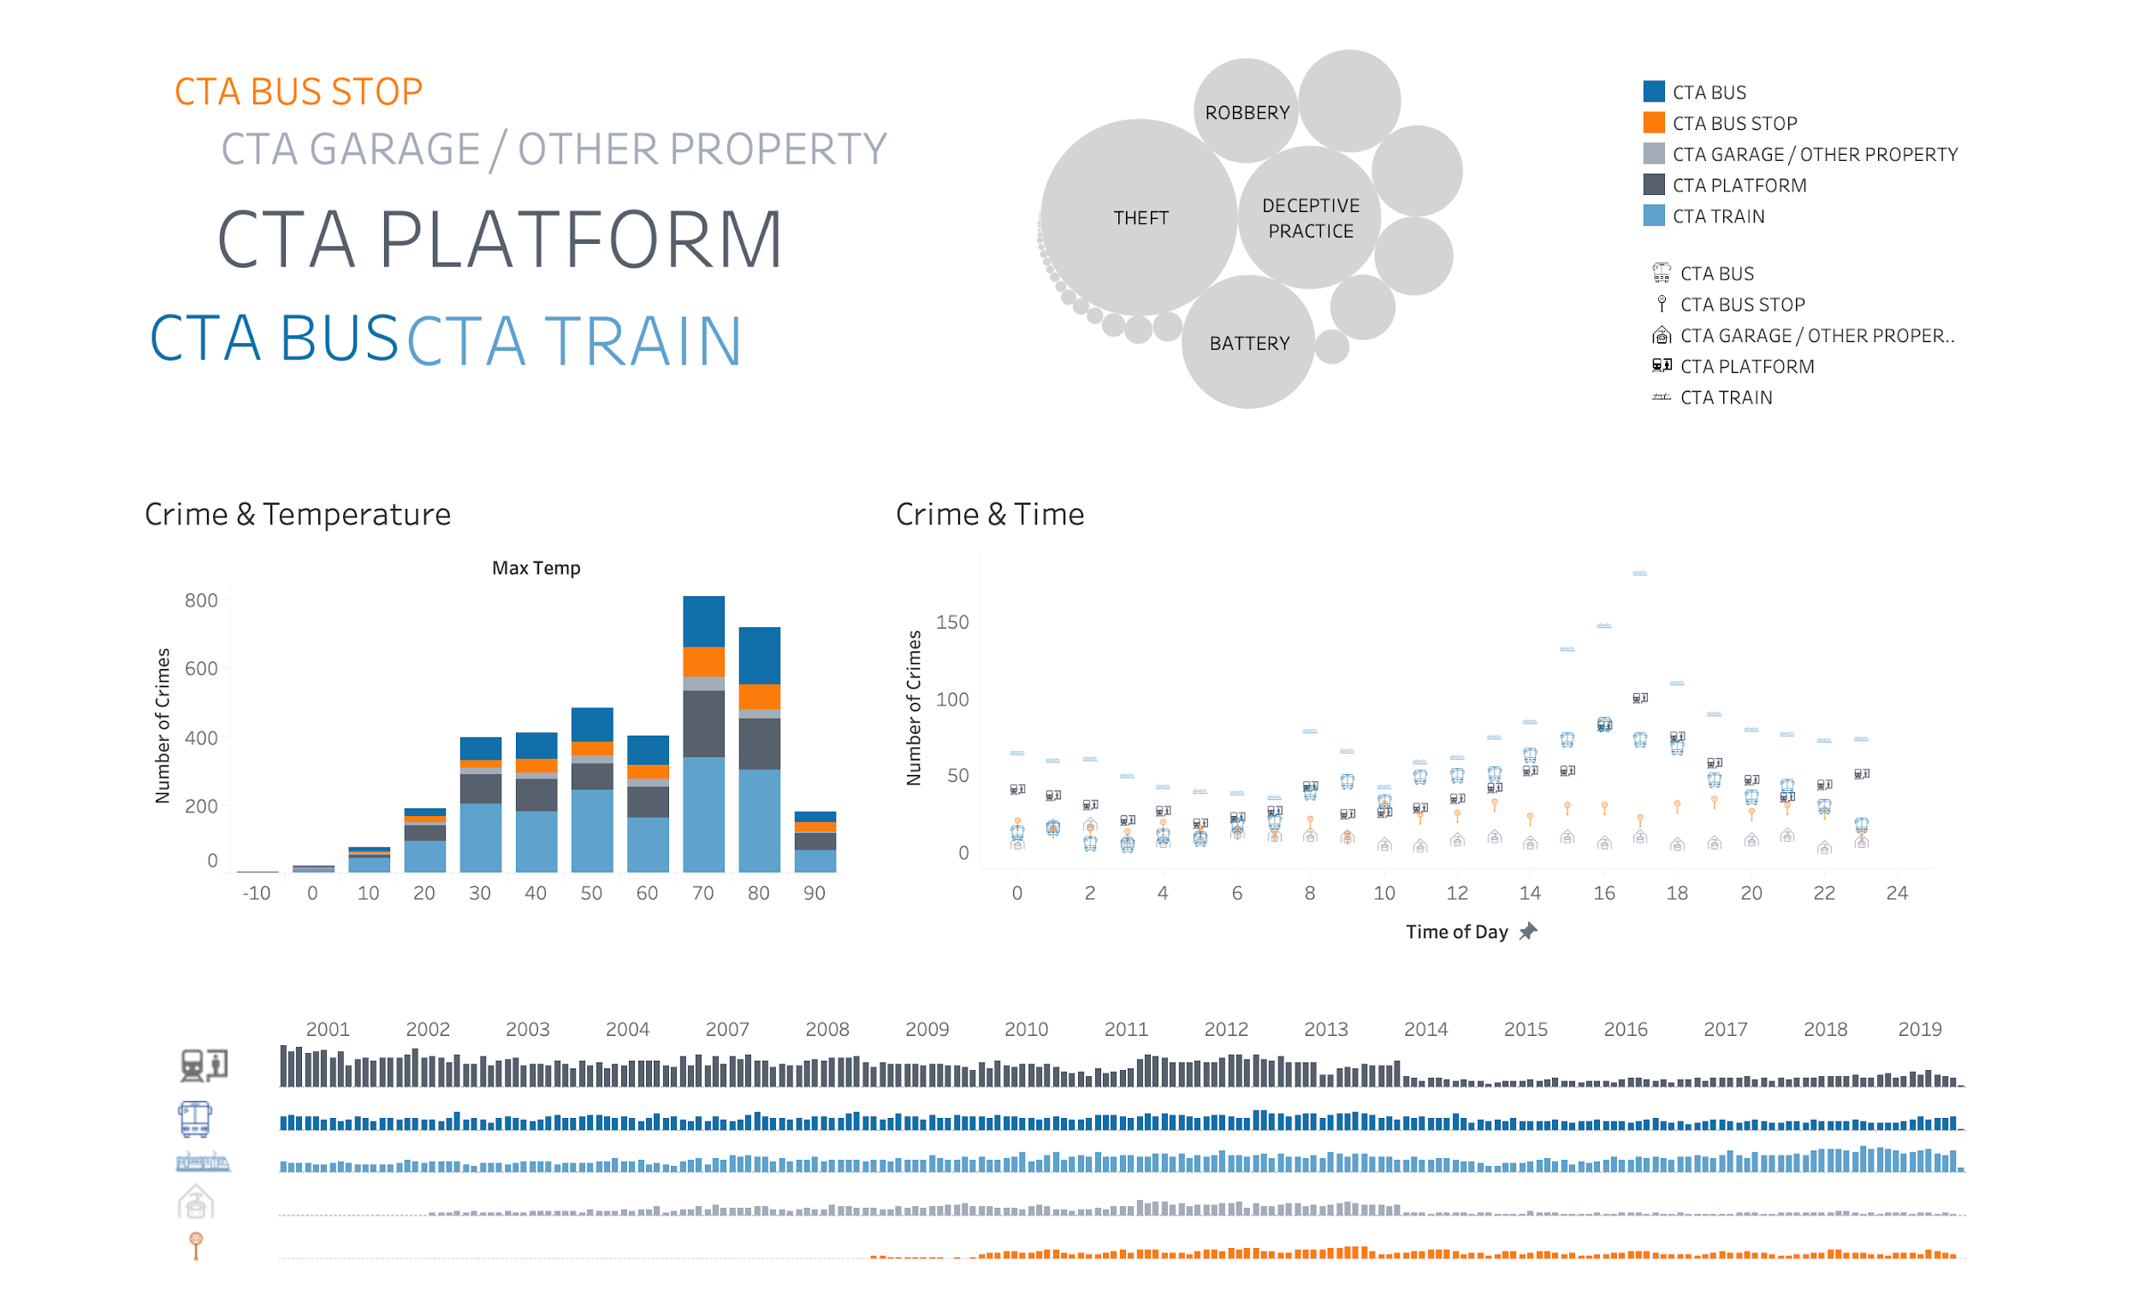
DASHBOARD | SUMMARY
Notes:
Summary dashboard to compare location types
color & icon coordinated
word cloud: compares volume of crime
bubble chart: compares types of crime
(already discussed crime & temp / crime & time)
last graph shows total occurrences of crime over the entire period from 2001 - 2019, each bar = 1 month
Key Takeaways
overall crime started decreasing significantly in 2014 -- which was the year the city finished installing 32,000 security cameras on CTA properties
source: https://www.transitchicago.com/2014-cta-year-in-review-2015-continues-historic-investment/
limited data for CTA Garages & Bus Stops - probably added new category definitions for data

Slide 25
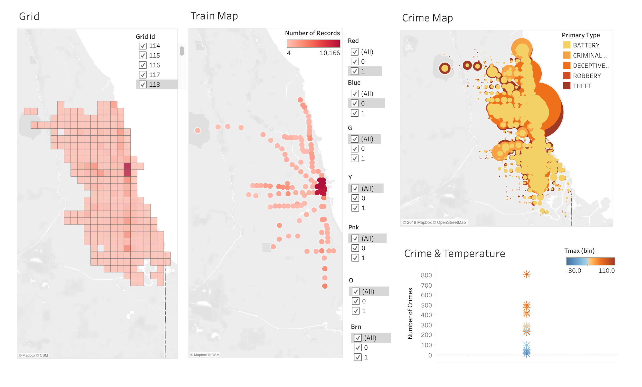
DASHBOARD | MAPS I
Notes:
2nd dashboard shows geographical data
Grid was covered by Julian
Train Map shows the number of crimes by line
Crime bubble map shows number of occurences by type of crime

Slide 26
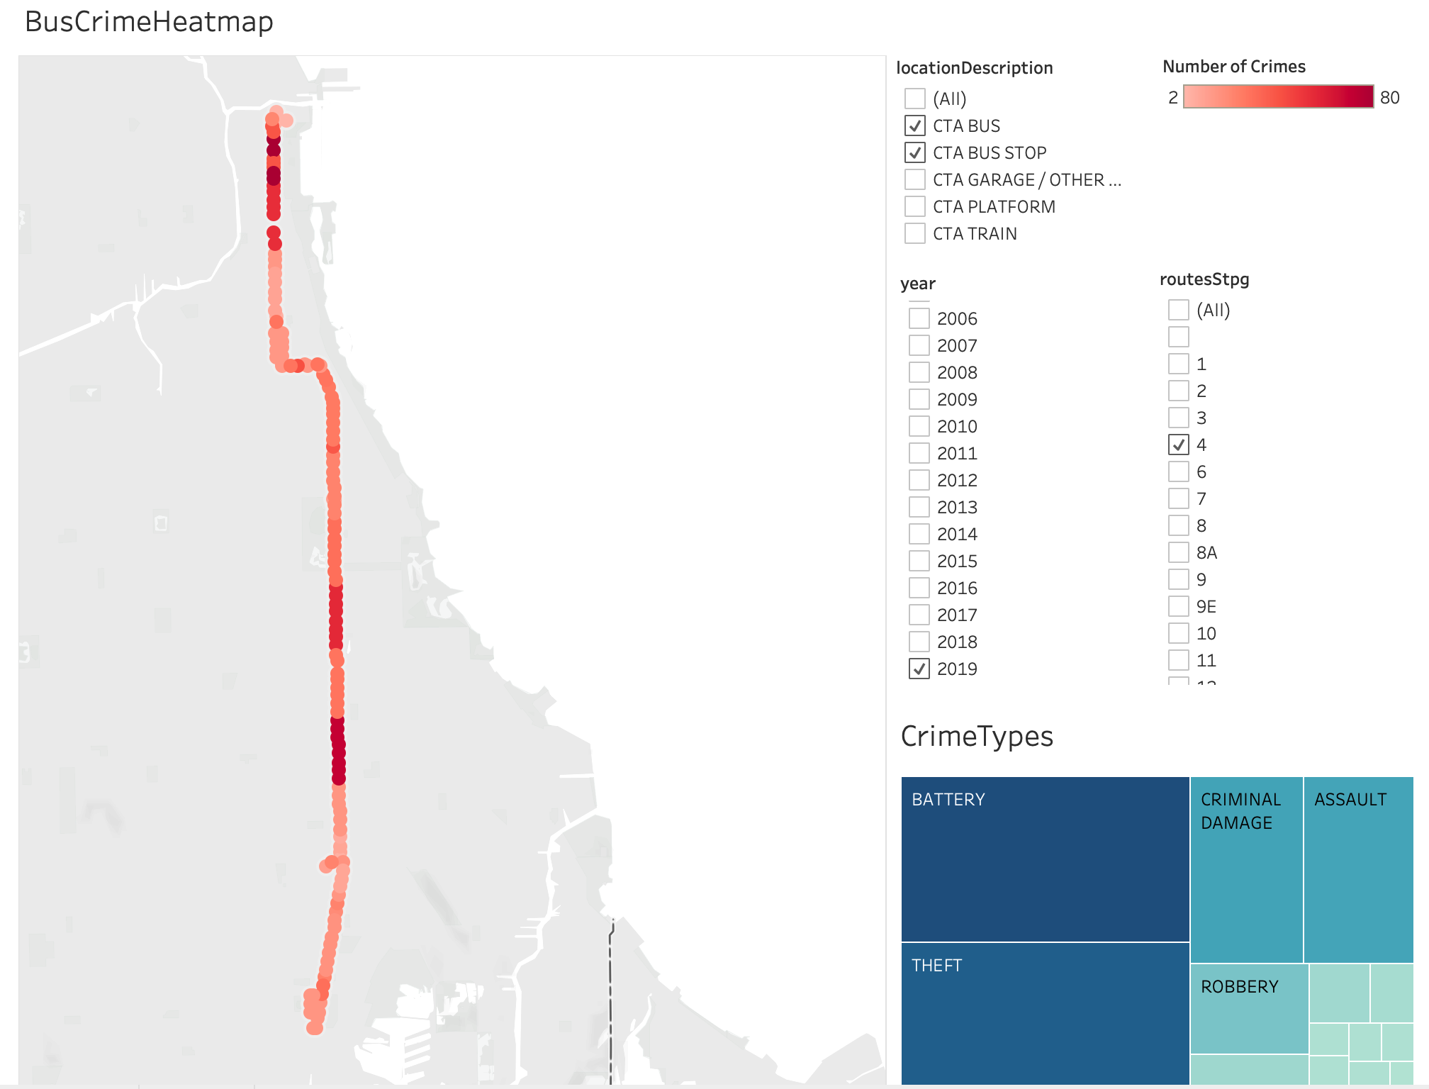
DASHBOARD | MAPS II

Slide 27


RECOMMENDATIONS
SIX SAFETY TIPS! When riding the CTA...
Take the bus and avoid the train
Mind your personal effects, there’s a lot of theft
Going Downtown or the Southside are both risky rides
If you must go west, buses are best
Peak hours for the criminal profession are in the PM between 2 and 7
When the weather is nice, think twice
Notes:
Easy Key Takeaways -- 6 safety tips when riding CTA

Slide 28
CONCLUSION

Slide 29
LESSONS LEARNED AND SCOPE FOR IMPROVEMENT
The better you know the data, the more accurate the analysis: We realized during the project that we needed ridership statistics to scale our metrics; some statistics weren’t recorded until 2008/2013.
Collaboration constraints: We primarily collaborated using GitHub, which worked fine except when multiple people worked on the same code simultaneously. Google Colab can be a useful alternative for simultaneous Jupyter Notebook editing.
Do it right from the start: Designing the database to be compatible with our analytics use-case would have saved us time. While performing analyses, we discovered problems with the availability and structure of data that forced us to alter our DDL and data preparation scripts.
Pitch your error: We all got stuck several times throughout the project and what helped us was to pitch the steps we took and the error we got to group members to reflect on the code and find a solution together.

